Slide 1
QNX - Your Next Generation RTOS Company
Larry Atkinson
Distribution Manager, EMEA

Slide 2


QNX Highlights
QNX/(KUE-nix):provider of realtime operating system (RTOS) software, development tools and services for mission critical embedded applications.
Over 2 decades of realtime embedded experience
Leader in innovative embedded technology
  First multitasking RTOS running with MMU support
  First RTOS to implement distributed processing
  First RTOS to implement symmetrical multi-processing
  First POSIX certified RTOS
  First microGUI Windowing system for embedded systems
Leading reputation for reliability and scalability
23 years
Experience!

Slide 3
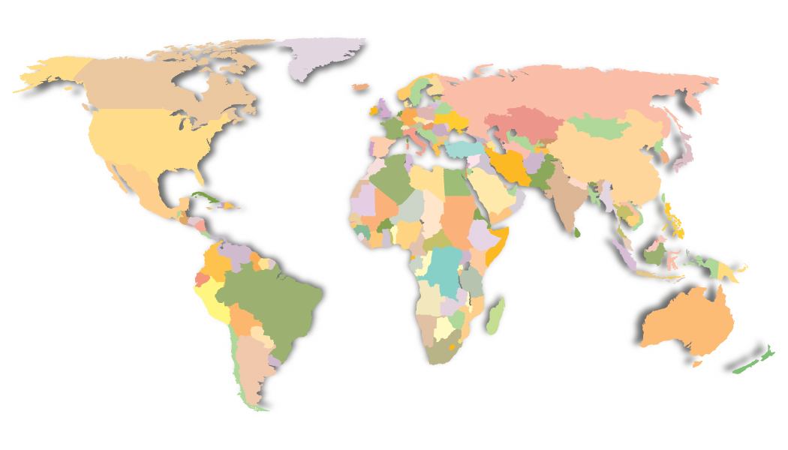
Global Coverage
Ottawa
Silicon Valley
Detroit
UK
Germany
Boston
France
Philadelphia
Tokyo
Irvine
Dallas
Headquarters
Offices
Distributors
Notes:
QNX has been in the RTOS business for over 20 years – as a result we have grown with our customers and listen and understand their challenges.
Founded in 1980,
Founder and CEO: Dan Dodge
Founder and Chairman: Gordon Bell
Corporate headquarters: Ottawa, Canada
240 employees
20 distributors representing 29 countries around the world

Slide 4

What We Do
We strive to be the best in all we do
QNX
Neutrino
the most reliable
realtime OS
RTOS Runtime
Modules
Development Tools:
Hosted on Windows,
Solaris, Linux or
Neutrino self-hosted
QNX Momentics
the most productive IDE
Custom
Engineering,
Support,Training
Support & Services
the most satisfied customers
QNX Software Systems
the company you can count on now and in the future
Experience &
Innovation

Slide 5
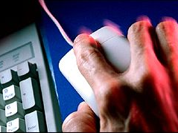


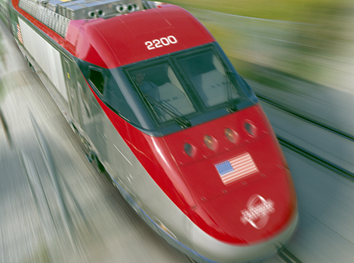
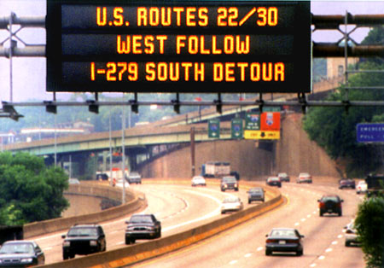
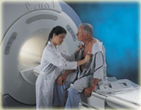


Making our Daily Lives Safer, Easier
QNX touches your life virtually every day, whenever you:
Surf the internet
Call 999
Use a credit card
Take a train
Drive to work
Visit the doctor
Turn on a light
Enjoy a blockbuster

Slide 6
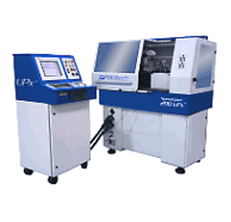
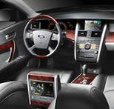
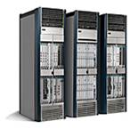

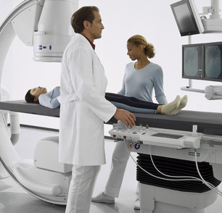
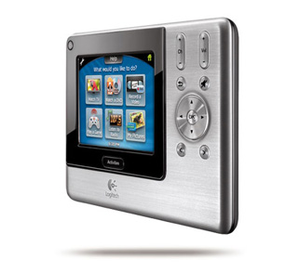
QNX Markets
Industrial
Automation
Automotive
Networking
Defense & Aerospace
Medical
Consumer
A diversified revenue base from several markets.
A diversified technology base from several markets.
QNX leverages innovation and experience across market segments
Notes:
Even though we specialize is certain markets, we know that there is a common layer of challenges that every developer encounters:
- Reliability – Developers want to ensure the system they build is highly reliable
Scalability – Will their system be able to grown and scale – without causing any interruption to the system?
Tools – Developers are faced with getting their product to market on time – productivity is essential and that is why FULLY integrated tools – that come right out of the box is key in accelerating development
Upgradeability and Performance – Once systems are in the field, companies may need to upgrade system without system failure.
QNX started out in the Industrial Automation market
Why QNX? Broad peripheral support on x86 and reputation for reliability. And our business and focus on Industrial continues to grow.
Our reputation for reliability and support for multiple processor families expanded our reach deeper into these markets
Demand for QNX is now growing in the Consumer Markets

Slide 7
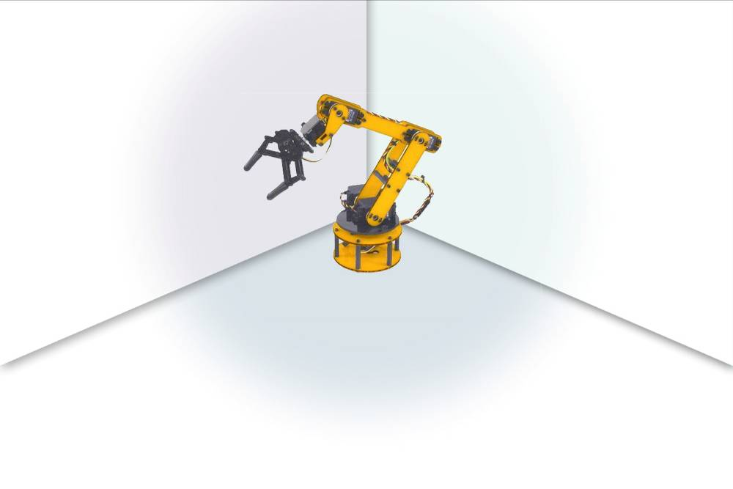






















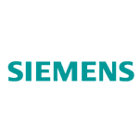








Industrial Automation Leadership
Realtime, mission critical performance
Notes:
Neil: For each of these logos, we need to know what they do with QNX. If we cannot disclose this, then just say “NDA”.

Slide 8
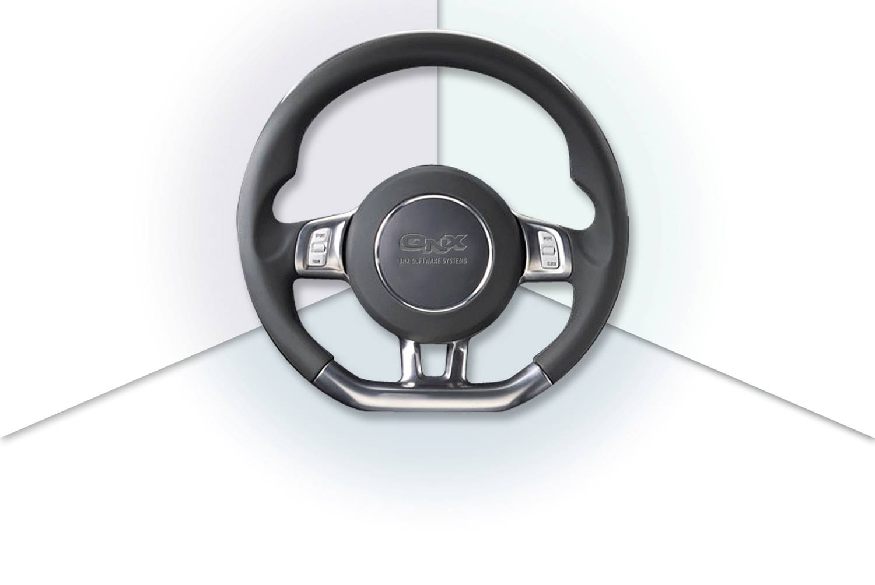






























Automotive Leadership
QNX is in 170 vehicle models
QNX automotive
Notes:
Neil: For each of these logos, we need to know what they do with QNX. If we cannot disclose this, then just say “NDA”.

Slide 9
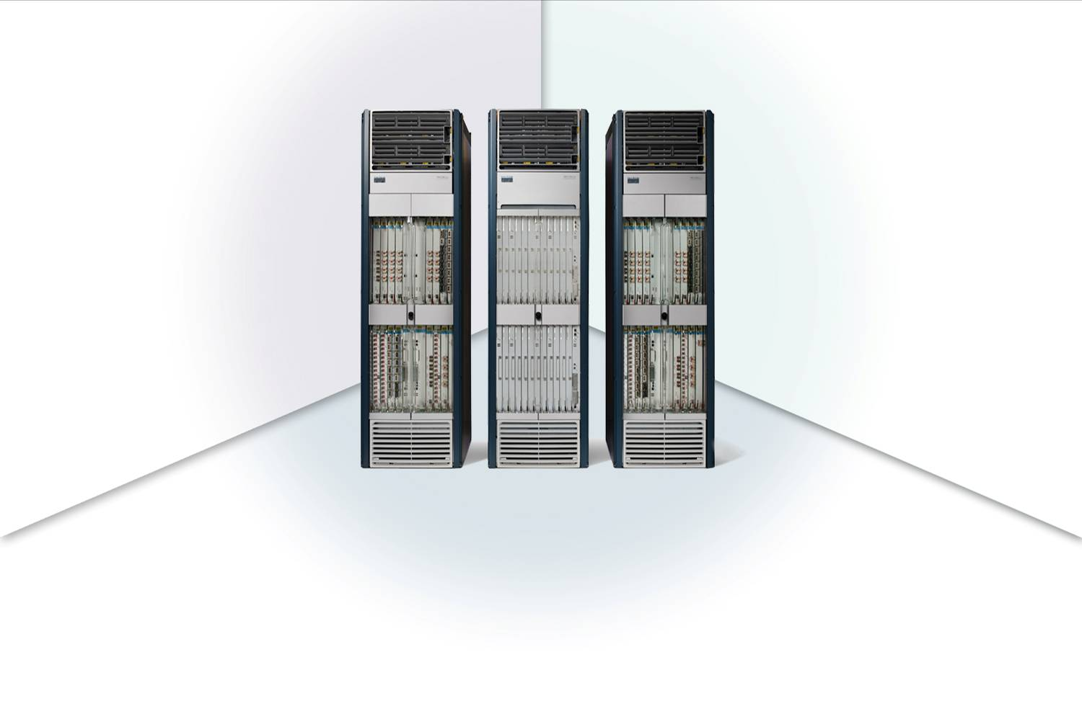
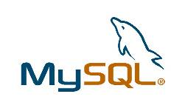

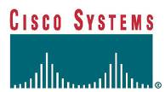











Networking Leadership
QNX powers the world’s highest capacity router
Notes:
Neil: For each of these logos, we need to know what they do with QNX. If we cannot disclose this, then just say “NDA”.

Slide 10
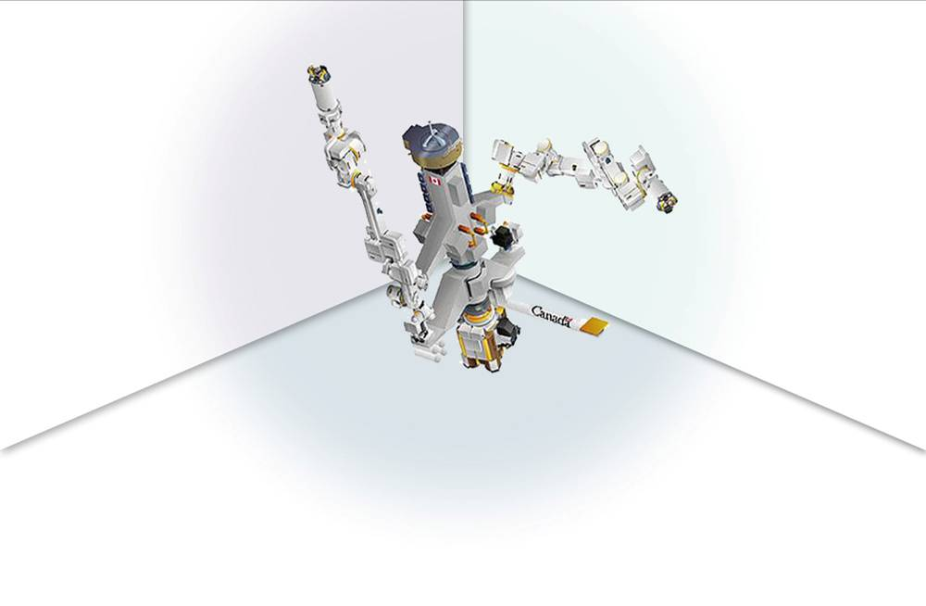
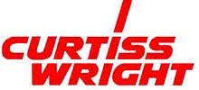









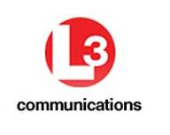
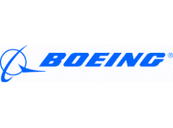







Defense and Aerospace Leadership
Secure, proven: On land and in space
Notes:
Neil: For each of these logos, we need to know what they do with QNX (i.e. Mission computer, etc). If we cannot disclose this, then just say “NDA”.

Slide 11







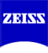






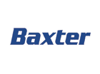
Medical Leadership
Medical devices require a reliable operating system
Notes:
Neil: For each of these logos, we need to know what they do with QNX (i.e. Apherisys machine, Blood Dialysis, etc, etc). If we cannot disclose this, then just say “NDA”.

Slide 12


QNX Advantages
Uncompromising Reliability
  Fault-tolerance, intelligent recovery, and high-availability for mission-critical systems
QNX has been in business for over 25 years !
  We sell to OEMs with long product life cycles (10+ years)
  We have a solid business model to ensure we will be there when you need us.
Predictable Realtime Performance
  Deterministic response times, both at the application level and within all subsystems
Unmatched Scalability
  Scale down to support memory-constrained devices or scale up to fully distributed SMP-based systems. Include only those modules/services your application needs
Clean IP - Our Engineers wrote QNX Neutrino!
  We own or have clear license to distribute the runtime products we provide
Notes:
QNX has been in the RTOS business for over 20 years – as a result we have grown with our customers and listen and understand their challenges.
Even though we specialize is certain markets, we know that there is a common layer of challenges that every developer encounters:
- Reliability – Developers want to ensure the system they build is highly reliable
Scalability – Will their system be able to grown and scale – without causing any interruption to the system?
Tools – Developers are faced with getting their product to market on time – productivity is essential and that is why FULLY integrated tools – that come right out of the box is key in accelerating development
Upgradeability and Performance – Once systems are in the field, companies may need to upgrade system without system failure.

Slide 13
QNX Advantages
Embeddable Photon microGUI < 1Mb
  Full featured, component based windowing system with a small footprint
  Built in internationalization. View different languages simultaneously
Standards-based RTOS (POSIX)
  Compliance with POSIX1003.1, realtime extensions, threads,etc.
  Access to a larget pool of developers and source code from other OS’s
Choice of Host and Target Platforms
  Develop from Windows, Linux or self hosted on QNX Neutrino itself
  Target ARM, MIPS, PowerPC, SH4, Xscale, or x86 boards
Standards-based Tools (Eclipse IDE Framework)
  Ability to plug in 3rd Party tools
  Participation of over 150 vendors
  QNX is board member and leads the C/C++ tooling project
Wide range of services to fit every need
  Scalable support plans make it affordable

Slide 14




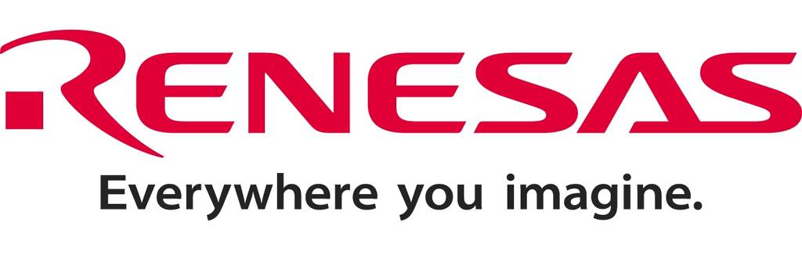
Multi-Core (SMP) Support
Every CPU maker is bringing a multi-core solution to market.
QNX supports more multi-core processors than an other real-time OS.
x86
ARM 11
PPC
SH4-X3
MIPS
QNX Neutrino supports three types of multi-core operation
Symmetric Threads can run on any processor
Bound Threads can be bound to any processor
Asymmetric Different OS’s can run on each processor
Concurrent support for symmetric and bound at the same time

Slide 15
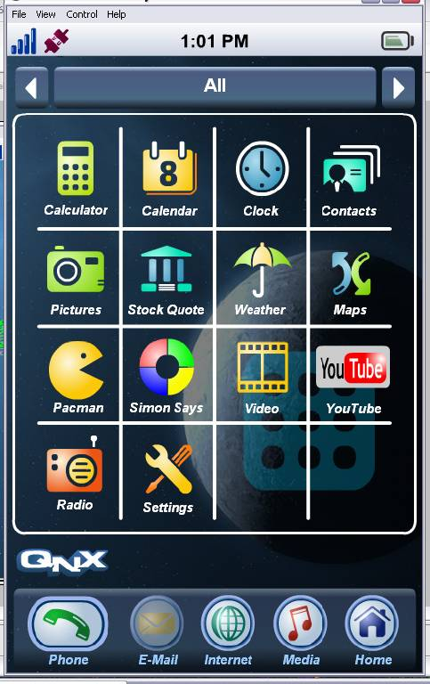
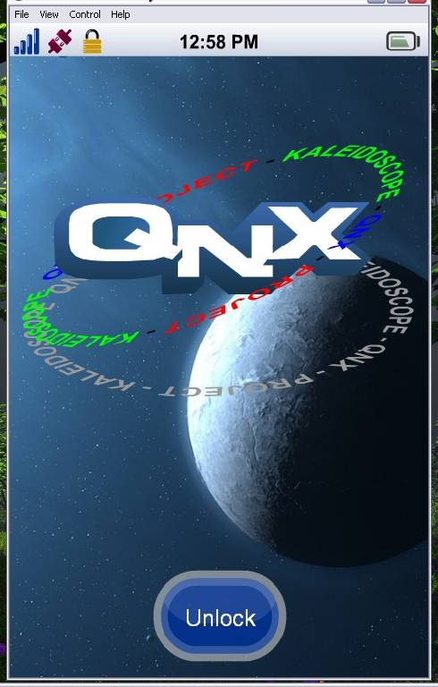
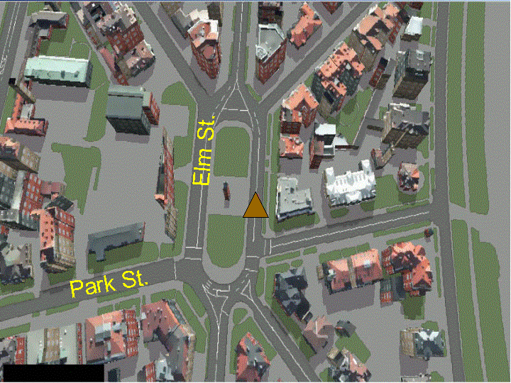
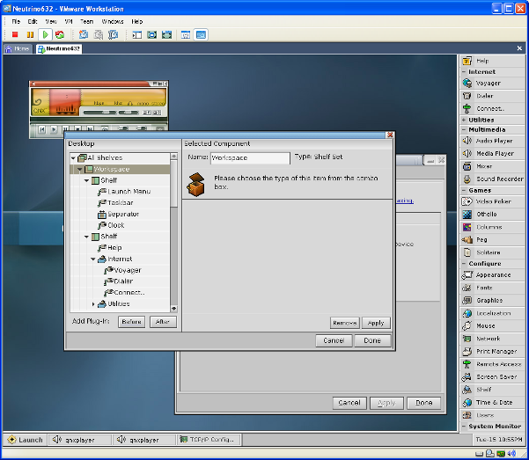
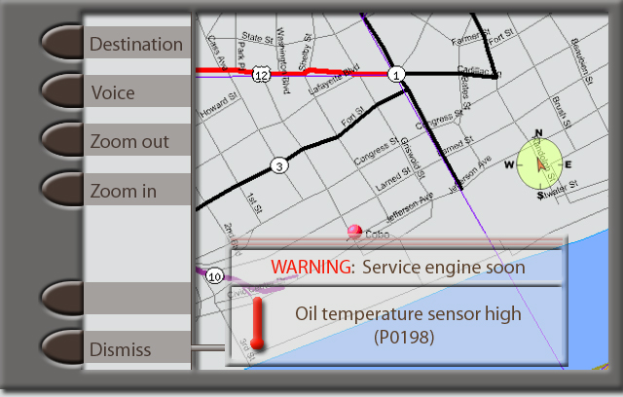




Range of HMI Development Options
Aviage HMI Player
(Embedded Flash)
Direct C/C++
Applications
Photon
Neutrino Graphics Core
Font support
Image support
OpenGL ES
OpenVG*
Device Drivers
* Engineering services engagement only
Notes:
Here is the main design of the Advanced Graphics Framework.
The middle component (graphics framework) and the graphics driver are the only mandatory components that an application needs when using the Advanced Graphics framework.
The graphics framework library manages draw surfaces and graphic layers… and also provides 2D drawing support.
The graphics driver is specific to the graphics chip and has all the 2D and 3D routines. There will be a mixture of hardware acceleration draw routines and software draw routines in the graphics driver.
An application starts up and loads the graphics framework library. The graphics driver is also loaded as a library. The application will make api calls that will call directly from the graphics framework library directly in to the graphics driver. There is no message copy from application to graphics driver. This gives us the highest performance possible.
As optional services, the application can load OpenGL ES libraries and make 3D api calls. And it could load OpenVG libraries and make 2D vector graphics calls. If desired the application can use font services … and use scalable fonts with anti-alias support based on TrueType and bitmap. Also available is stroked font technology from Bitstream.. supporting Japanese character sets in small size font files (less than 500K).
Image libraries for PNG, JPG, BMP etc. can also be used, with support for decode and encode as well as scaling of images.

Slide 16
Contact QNX
Larry Atkinson (latkinson@qnx.com)
  613 291-5752 cell
  613 271-9338 office
North America
  T : +1-800-676-0566
  F : +1-613-591-3579
International
  T: +1-613-591-0931
  F: +1-613-591-3579
Online
  Info@qnx.com
  www.qnx.com

